Slide 1

FTI CONSULTING PRESENTATION TO THE FOODDRINKEUROPE BREXIT WORKING GROUP
21 MARCH 2017

Slide 2

FTI CONSULTING TEAM - INTRODUCTIONS
Our team:
Louise Harvey, Chair Strategic Communications Brussels, Head of the FTI Brexit taskforce
Dr. Meloria Meschi, Senior Managing Director, Economic and Financial Consulting, London
Ravi Kanabar, Director, Economic and Financial Consulting, London
Jonathan Bradshaw, Consultant, Economic and Financial Consulting, London
Joost Koomen, Senior Director Strategic Communications, FTI Brexit taskforce, Brussels

Slide 3
BREXIT: IMPACT ON THE FOOD AND DRINKS INDUSTRY
The road to the future EU27/UK relationship is paved with known & unknown unknowns
Few scenarios possible/realistic
Imposition of at least some tariffs & quotas likely
Non-tariff barriers likely to reoccur
Significant impact on bottom line hard to avoid
Transition period desirable – the duration will be up for debate. Art. XXIV GATT?
Industry must prepare for both potential regulatory and economic impact

Slide 4
SCENARIOS FOR A FUTURE EU-UK RELATIONSHIP
Decision to leave Single Market means few realistic options:
Tailor-made FTA / ‘Accession/affiliation’ agreement: CETA + or Ukraine-style
    Elimination of most tariffs/quotas
    Regulatory cooperation – exact scope/extent will be crucial
    Mutual acceptance of standards – exact scope/extent will be crucial
    Customs facilitation
  WTO rules
    WTO tariffs applicable
    Implications for sector specific rules and agreements (SPS and the Codex Alimentarius)?
Scenarios could be accompanied by some kind of stand-alone Customs Agreement going beyond standard customs & trade facilitation provisions of an FTA

Slide 5

DIRECT EFFECTS OF A ‘HARD BREXIT’ ON 10 EU FOOD AND DRINK EXPORTS TO THE UK

Slide 6
IMPORTANCE OF EU FOOD AND DRINK EXPORTS TO UK
The food and drink industry makes a significant contribution to the EU’s economy.
Exports to the UK are an important part of this contribution.
For example, the total value of food and drink exports from the EU to the UK was €32 billion, in 2016.
We will focus on 10 key products and exporting countries (next slide).
Source: (1) FoodDrinkEurope, Data & Trends, 2016; (2) Eurostat; (3) FTI calculations
€1,089 billion in revenues
4.25 million jobs
1.8% of EU GVA

Slide 7
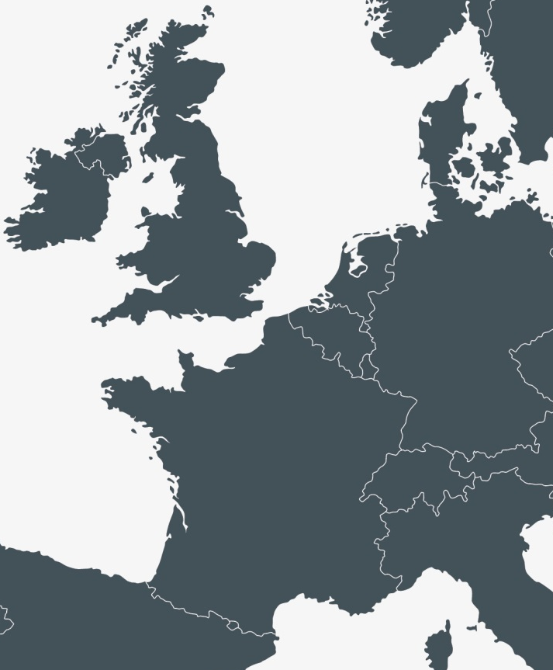
KEY FOOD AND DRINK EXPORTS TO THE UK IN 2016
€834m
Irish beef
€383m
German bread, pastry, cakes and biscuits
€256m
Belgian chocolate
€286m
French cheese
€1,076m
French wine
€321m
Italian pasta
Source: Eurostat.
Notes: our analysis also considers exports of other meat from Ireland, vegetables from the Netherlands, wine from Italy, and cheese from Ireland.

Slide 8
A ‘HARD BREXIT’ WILL SIGNIFICANTLY IMPAIR COMPETITIVENESS OF EU EXPORTS TO UK
If no free trade agreement is in place when the UK leaves the EU, trade relations revert to WTO rules (‘hard Brexit’).
The WTO’s ‘most favoured nation’ (MFN) tariffs are complex.
They include a combination of:
Purely specific tariffs (EUR/quantity)
Purely ad valorem tariffs (% of price)
Mixed tariffs (both specific and ad valorem)
Composition dependent tariffs (depending on fat, sugar, flour, etc. in the product ingredients.)
There may also be non-tariff barriers to trade (although these are not included in our analysis).

Slide 9
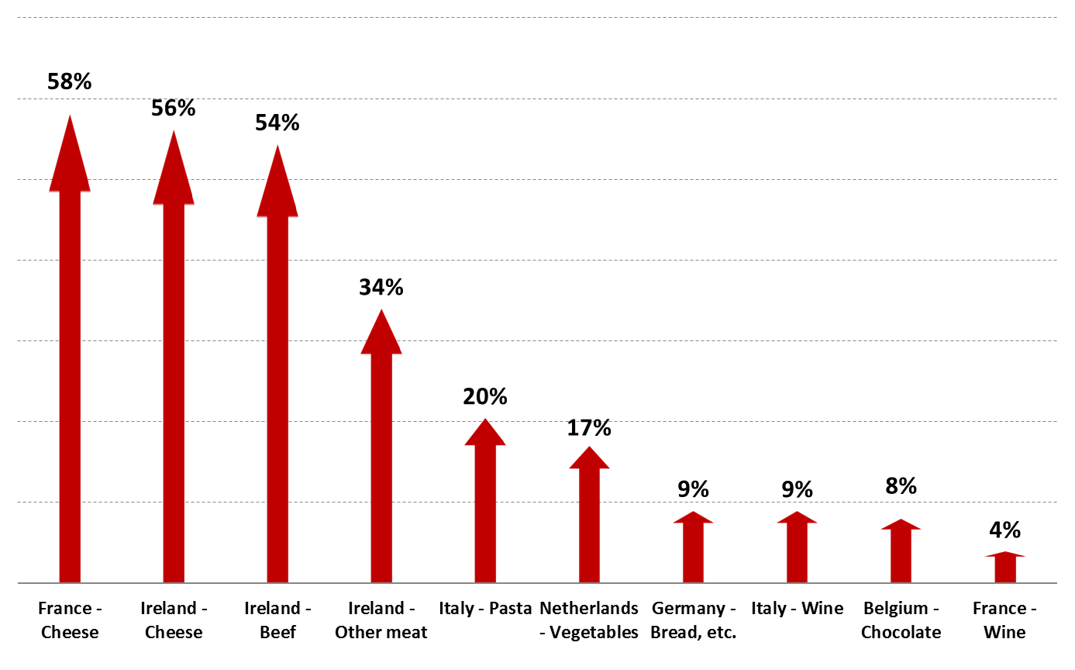
WTO MFN TARIFFS COULD INCREASE EU FOOD
AND DRINK EXPORT PRICES SIGNIFICANTLY
Source: FTI calculations.
Notes: (1) calculations are based on approximations of the WTO MFN tariffs, (2) these approximations understate the tariffs on bread and chocolate , and so the price increase for these products may be greater than shown above, (3) all calculations assume the tariff is passed on in full.

Slide 10
LEVELS OF TRADE ARE HIGHLY SENSITIVE TO TRADE PRICES
European Commission has commissioned research into ‘trade price elasticities’ in 2010.
Estimates updated by the same authors in 2016:
-4.85
Food
1% increase in price of food exported to the UK, reduces quantity of exports by ~4.85%
-4.74
Beverages
1% increase in price of beverages exported to the UK, reduces quantity of exports by ~4.74%
Source: (1) Imbs and Mejean (2010); (2) Imbs and Mejean (2016).

Slide 11
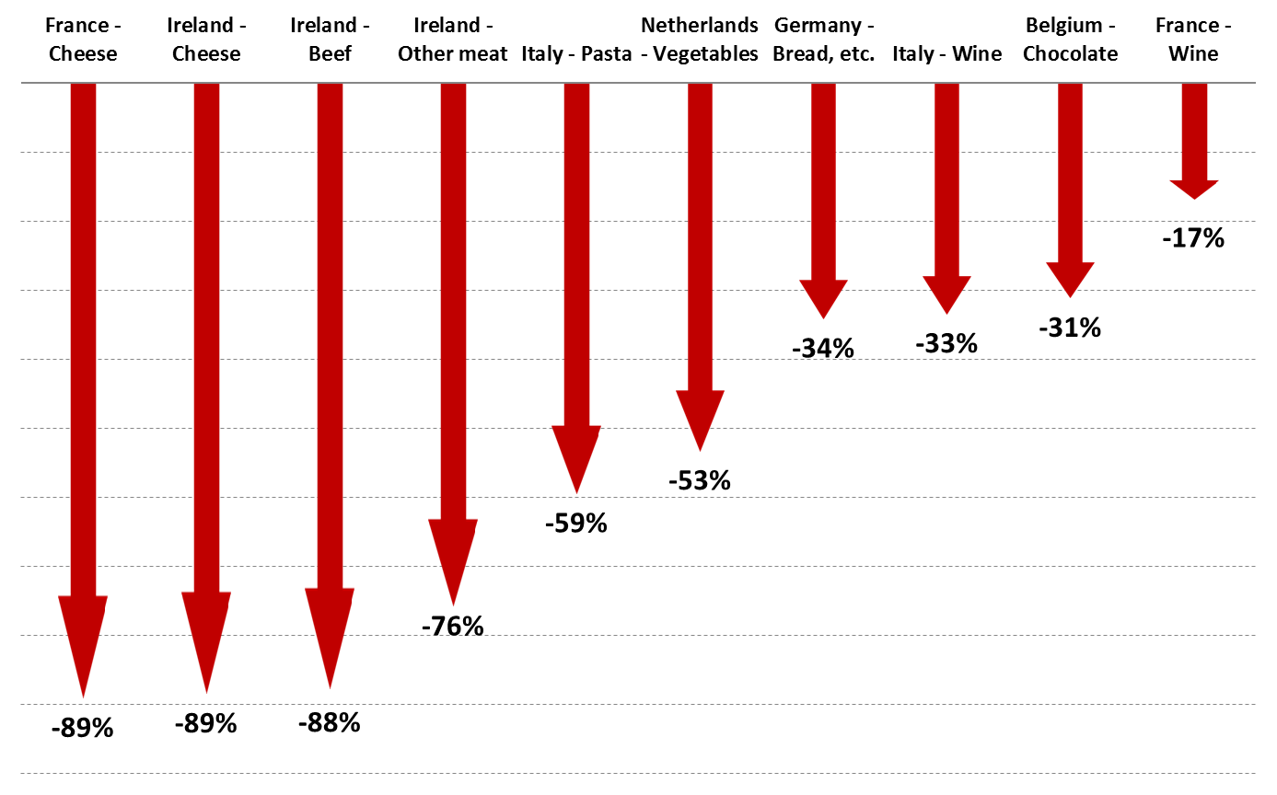
HIGHER TRADE PRICES WILL THEREFORE CAUSE EXPORT VOLUMES FROM THE EU TO THE UK TO DROP SIGNIFICANTLY
Source: FTI calculations.

Slide 12
REVENUES FOR EXPORTS FROM EU TO UK WOULD THEN FALL SIGNIFICANTLY
Source: FTI calculations. Notes: (1)revenues measured in EUR million; (2) the calculations assume the tariff is passed on in full, and so the fall in revenue is proportional to the fall in export volumes.

Slide 13
THOUSANDS OF EU JOBS ARE AT RISK OF BEING LOST
EU food and drink manufacturers may require fewer employees, as smaller volumes of food and drink need to be produced
Country | Product | Number of manufacturing jobs at risk
Germany | Bread, pastry, cakes and biscuits | 3,200
Ireland | ‘Other’ meat | 1,700
Ireland | Beef (and veal) | 1,500
Italy | Pasta | 1,300
Netherlands | Vegetables | 700
Italy | Wine | 700
Ireland | Cheese | 400
France | Cheese | 400
Belgium | Chocolate | 200
France | Wine | 200
Source: FTI calculations based on Eurostat data. Notes: (1) calculations assume that productivity (volume produced per employee) is unchanged; (2) jobs at risk correspond to the manufacture of food and drink products. Indirect and induced effects are not included.

Slide 14
OUR ESTIMATES ARE NOT YET COMPLETE
We have estimated direct impacts. However, there will also be indirect and
induced impacts:
We have considered tariff barriers. Non-tariff barriers may reduce trade even further.
We have assumed that EU exporters pass on the tariffs to importers. However, exporters may share in the incidence of the tax.
Total
impact
Direct impact
Indirect impact
Induced impact
e.g. fall in output, revenue and jobs at risk, on previous slides
e.g. fall in cheese production has a knock on effect further back and forward in the supply chain (e.g. milk production)
e.g. cheese production workers with lower incomes or no job, reduce spending elsewhere in the economy, so there is lower production in other sectors too

Slide 15
COMPLETING AND EXTENDING OUR ECONOMIC ANALYSIS
Complete the analysis, improve robustness:
Full economic impact (including indirect and induced)
Review economic assumptions underlying the analysis, based on a review of the underlying evidence base on (a) tariff pass-through rates and (b) trade elasticities.
Update the calculations at a less aggregate level (and applying the tariffs at the 8 digit level)
Extensions:
Consider effect on the UK
Include all food and drink products (rather than just 10)
Reflect non-tariff barriers
Consider effect on the cost of a UK consumer's average food basket

Slide 16
HOW COULD FOODDRINKEUROPE LEVERAGE THE RESULTS

Slide 17
HOW COULD FOODDRINKEUROPE LEVERAGE THE RESULTS
So what?
Support political/regulatory advocacy with a broader comms campaign (in Brussels, London and MS)
Goal: to raise awareness and ensure food and drink products form a crucial part of the negotiations

Slide 18
HOW COULD FOODDRINKEUROPE LEVERAGE THE RESULTS
Some suggested tactics :
Clear call to action
Identify a real life case study/spokesperson
Pitch the story for broadcasters as well as top tier print
(could have good visual elements)
Infographic in national language / infographic showing difference
in 5 key markets
Social media campaign to explain the consequences and explain
the stories of those that would be impacted

Slide 19
HOW CAN WE HELP?
With dedicated teams in London and Brussels, FTI Consulting is well placed to support and help you understand the political landscape coupled with an assessment of the practical challenges.
An integrated suite of advisory services, combing political understanding and operational expertise
Analytical skills to improve visibility and information flows to fully support corporate decision making
A multidisciplinary team to help you navigate the uncertainty, manage change, risk and corporate reputation
Intelligence and analysis at each step of an evolving process to secure your trading, regulatory and operating environment
Dedicated teams in London and Brussels with intimate knowledge of the institutions on both sides of the Channel
A comprehensive European and global network combing professional expertise, commercial understanding with local knowledge and context
Contact us: louise.harvey@fticonsulting.com - meloria.meschi@fticonsulting.com

